Slide 1
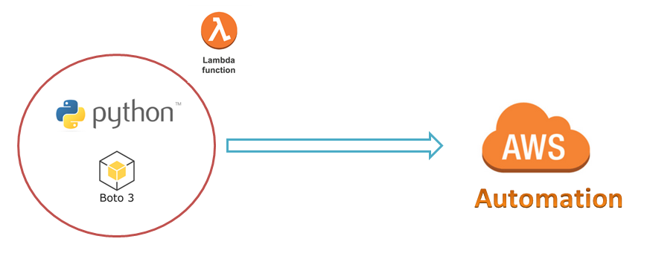
AWS Automation
with
boto3 of Python and Lambda Functions
How to install Python-3.x and boto3 on Linux Server ?
Loop control statements or commands
(break and continue)
Learn how to automate AWS common tasks using boto3 and Lambda

Slide 2
Thank you

